Slide 1
Chapter 10
GIBBS FREE ENERGY COMPOSITION AND PHASE DIAGRAMS OF BINARY SYSTEMS
  INTRODUCTION
It has been seen that, at constant temperature and pressure, the stable state of existence of a system is that which has the minimum possible value of Gibbs free energy. Thus, phase stability in a system, as normally presented on an isobaric phase diagram, can be determined from knowledge of the variations of the Gibbs free energies of the various possible phases with composition and temperature. When a liquid solution is cooled, a liquidus temperature is eventually reached, at which point a solid phase begins to separate from the liquid solution. This solid phase could be a virtually pure component, a solid solution of the same or different composition from the liquid, or a chemical compound formed by reaction between two or more of the components. In all possible cases the composition of the solid phase which is in equilibrium with the liquid solution is that which minimizes the Gibbs free energy. If liquid solutions are stable over the entire range of composition, then the Gibbs free energies of the liquid states are lower than those of any possible solid state, and conversely, if the temperature of the system is lower than the lowest solidus temperature, then the Gibbs free energies of the solid states are everywhere lower than those of liquid states. At intermediate temperatures, the variation of Gibbs free energy with composition will identify ranges of composition over which liquid states are stable, ranges over which solid states are stable, and intermediate ranges in which solid and liquid phases coexist in equilibrium with one another. Thus, by virtue of the facts that (1) the state of lowest Gibbs free energy is the stable state and (2) when
phases coexist in equilibrium has the same value in all of the coexisting phases, there must exist a quantitative correspondence between Gibbs free energy-composition diagrams and “phase diagrams.” This correspondence is examined in this chapter, in which it will be seen that “normal” phase diagrams are generated by, and are simply representations of, Gibbs free energy-composition diagrams.
  GIBBS FREE ENERGY AND THERMODYNAMIC ACTIVITY
The Gibbs free energy of mixing of the components A and B to form a mole of solution is given by
and OG^{M} is the difference between the Gibbs free energy of a mole of the homogeneous solution and the Gibbs free energy of the corresponding numbers of moles of the unmixed components. As only changes in Gibbs free energy can be measured, the Gibbs

Slide 2
Gibbs Free Energy Composition and Phase Diagrams of Binary Systems 311
free energies of the pure unmixed components are assigned the value of zero. If the solution is ideal, i.e., if a_{i}=X_{i}, then the molar Gibbs free energy of mixing, given by
has the characteristic shape shown, at the temperature T, as curve I in Fig. 10.1. As then and hence curve I in Fig. 10 1 is obtained as
–T×(the curve drawn in Fig. 9.7). It is thus seen that the shape of the variation of OG^{M,id}
with composition depends only on temperature.
If the solution exhibits a slight positive deviation from ideal mixing, i.e., if μi>1 and
a_{i}>X_{i}, then, at the temperature T, the Gibbs free energy of mixing curve is typically as
shown by curve II in Fig. 10.1; and if the solution shows a slight negative deviation from ideal mixing, i.e., if μi<1 and a_{i}<X_{i}, the Gibbs free energy of mixing curve is typically as
shown by curve III in Fig. 10.1. From Eqs. (9.33a and b) the tangent drawn to the OG^{M}
curve at any composition intersects the X_{A}=1 and X_{B}=1 axes at and ,
respectively, and, as In a_{i}, a correspondence is provided between the
OG^{M}-composition and activity-composition curves. In Fig. 10.1, at the composition Y,
tangents drawn to curves I, II, and III intersect the X_{B}=1 axis at a, b, and c, respectively. Thus
from which it is seen that
The variation, with composition, of the tangential intercepts generates the variations of activity with composition shown in Fig. 10.2.
As X_{i} → 0, a_{i} → 0, and hence the tangential intercept which
indicates that all Gibbs free energy of mixing curves have vertical tangents at their extremities. Similarly, by virtue of being logarithmic, the entropy of the mixing curve shown in Fig. 9.7 has vertical tangents at its extremities.

Slide 3
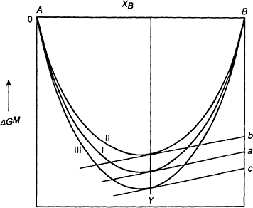
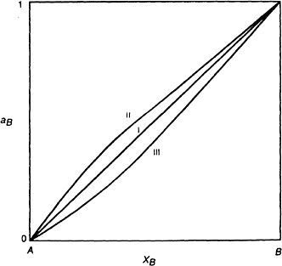
312 Introduction to the Thermodynamics of Materials
Figure 10.1 The molar Gibbs free energies of mixing in binary systems exhibiting ideal behavior (I), positive deviation from ideal behavior (II), and negative deviation from ideal behavior (III).
Figure 10.2 The activities of component B obtained from lines I, II, and III in Fig. 10.1.

Slide 4
Gibbs Free Energy Composition and Phase Diagrams of Binary Systems 313
10.3 THE GIBBS FREE ENERGY OF FORMATION OF REGULAR SOLUTIONS
If curves II and III in Fig. 10.1 are drawn for regular solutions, then deviation of OG^{M} from OG^{M,id} is due only to the nonzero heat of mixing and the difference between the two curves, OG^{M}–OG^{M.id}
For curve II, and thus OH^{M} is a positive quantity (a and fi are positive quantities). It is of interest to consider the effect of increasingly positive values of a on the shape of the Gibbs free energy of mixing curve for a regular solution. In Fig.
10.3, curve I is drawn as—
OG^{M,id}/RT. Curves for
This curve represents are drawn for a=0, +0.5, +1.0, +1.5, +2.0,
+2.5, and +3.0, and the corresponding OG^{M}/RT curves are drawn as the sum of the particular OH^{M}/RT and –OS^{M,id}/R curves. As the magnitude of a is increased it is seen that the shape of the OG^{M}/RT curve continuously changes from a shape typified by a=0 to a form typified by a=3. Before discussing the consequences of this change of shape on the

Slide 5
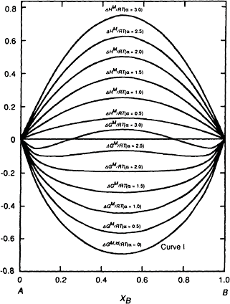
314 Introduction to the Thermodynamics of Materials
Figure 10.3 The effect of the magnitude of a on the integral molar heats and integral molar Gibbs free energies of formation of a binary regular solution.
behavior of the solutions, it is pertinent to examine the significance of the shape of the curve. Curve I from Fig. 10.1 is reproduced in Fig. 10.4a. This curve is “convex downwards” at all compositions. Thus the homogeneous solution formed from any mixture of A and B is the stable state, as this state has the lowest possible Gibbs free en- ergy. Consider, further, two separate solutions, say, a and b in Fig. 10.4a. Before mixing of these two solutions, the Gibbs free energy of the two-solution system, with respect to pure A and pure B, lies on the straight line joining a and b, with the exact position being determined, via the lever rule, by the relative proportions of the separate solutions. If the solutions a and b are present in equal amounts then the Gibbs free energy of the system is given by the point c. When mixed, the two solutions form a new homogeneous solution, as thereby the Gibbs free energy of the system is decreased from c and d, the minimum Gibbs free energy which it can have. Consider now Fig. 10.4b in which the OG^{M}/RT curve for a=+3.0 is reproduced from Fig. 10.3. This curve is “convex

Slide 6
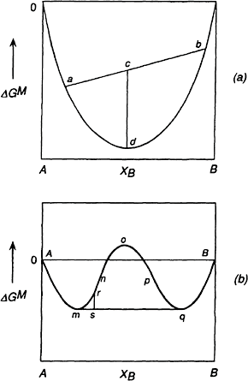
Gibbs Free Energy Composition and Phase Diagrams of Binary Systems 315
downwards” only between a and n and between p and B and is “convex upwards” between n and p. The Gibbs free energy of a system of composition between m and q is minimized when the system occurs as two solutions, one of composition m and the other of
Figure 10.4 (a) The molar Gibbs free energies of mixing of binary components which form a complete range of solutions. (b) The molar Gibbs free energies of mixing of binary components in a system which exhibits a miscibility gap.
composition q; e.g., if the homogeneous solution of composition r separates into the two coexisting solutions m and q, the Gibbs free energy of the system is decreased from r to s. The equilibrium coexistence of two separate solutions at the temperature T and pressure P requires that
(i)

Slide 7
316 Introduction to the Thermodynamics of Materials
and
(ii)
Subtracting
from both sides of Eq. (i) gives
or
Similarly
(iv)
Equations (iii) and (iv) are the criteria for equilibrium coexistence of two solutions (or
phases) at constant T and P. As (in m)= (in q), and (in m)=
(in
q), then it is seen that the tangent to the curve at the point m is also the tangent to the curve at the point q. The positioning of this double tangent defines the positions of the points m and q on the Gibbs free energy of mixing curve.
The A-B system, as represented in Fig. 10.4b, is one in which, at the temperature T, the value of a is sufficiently positive that the consequent tendency toward clustering of like atoms is great enough to cause phase separation. A homogeneous solution (phase I) is formed when B is initially added to A and saturation of phase I with B occurs at the composition m. Further addition of B causes the appearance of a second solution (phase
II) of composition q (which is phase II saturated with A), and continued addition of B causes an increase in the ratio of phase II to phase I occurring, until the overall composition of the two-phase system reaches q, at which point phase I disappears. A homogeneous solution (phase II) occurs between the compositions q and B. The curve mn represents the Gibbs free energy of phase I supersaturated with B, and the curve qp represents the Gibbs free energy of phase II supersaturated with B. As the line AmqB represents the equilibrium states of the system, then this line alone has physical significance, and the line is the isobaric, isothermal section of the system as it occurs in G-T-P-composition space.
10.4 CRITERIA FOR PHASE STABILITY IN REGULAR SOLUTIONS
For a given temperature it is obvious that a critical value of a occurs below which a homogeneous solution is stable over the entire range of composition and above which

Slide 8
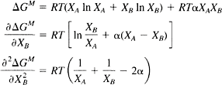


Gibbs Free Energy Composition and Phase Diagrams of Binary Systems 317
phase separation occurs. The criteria used to determine this critical value are illustrated in
Fig. 10.5. Fig. 10.5a, b, and c show the variations of
, ,
and with composition for a<a_{critical}, a=a_{critical}, and a>a_{critical} respectively.
The critical value of a is seen to be that which makes and simultaneously equal to zero at that composition at which immiscibility becomes imminent. For a regular solution,
and
The third derivative, derivative,
and thus the second when a=2, which is thus the critical
value of a above which phase separation occurs. As a is an inverse function of temperature, given by
a critical temperature occurs in any regular system with a positive value of fi, above which a<2 and below which a>2. The critical temperature, T_{cr}, is
(10.1)
Fig. 10.6a shows the variation, with temperature, of the Gibbs free energy of mixing curve for a regular solution which has a positive molar heat of mixing (fi=16,630 joules) and a critical temperature of T_{cr}=16,630/2R=1000 K. The Gibbs free energy expression
contains a negative logarithmic term, the magnitude of which is proportional to temperature, and a positive parabolic term which is independent of temperature. At high enough temperature, the logarithmic contribution predominates and the Gibbs free energy

Slide 9
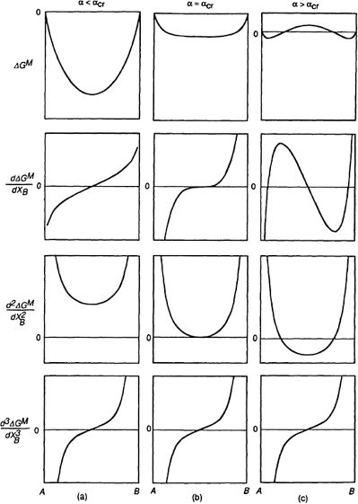
318 Introduction to the Thermodynamics of Materials
of mixing is convex downwards at all compositions. However, with decreasing temperature, the contribution of the logarithmic term decreases, and eventually the positive parabolic term predominates and produces a range of composition centered on X_{B}=0.5 over which the Gibbs free energy curve is convex upwards. The logarithmic term
still requires that the tangents to the curve at X_{A}=1 and X_{B}=1 be vertical. Fig. 10.6b shows
the phase diagram for the system, in which the miscibility curve bounding the two-phase region is simply the locus of the double tangent compositions in Fig. 10.6a. The influence of temperature on the variations of the activity of component B with composition is shown in Fig. 10.6c. The activities are obtained from the intercepts, with the X_{B}=1 axis,
Figure 10.5 The effect of the magnitude of a on the first, second, and third derivatives of the integral Gibbs free energy of mixing with respect to composition.

Slide 10
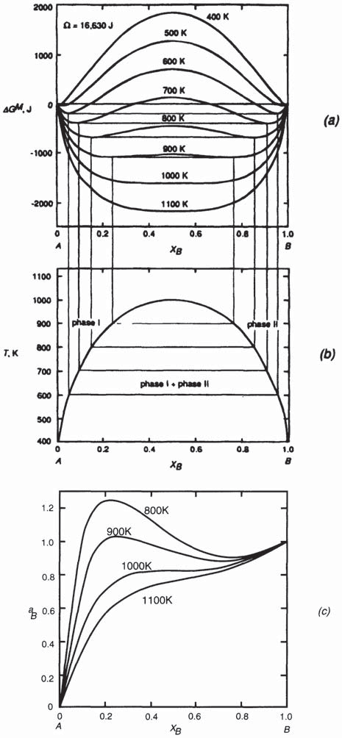
Gibbs Free Energy Composition and Phase Diagrams of Binary Systems 319
Figure 10.6 (a) The effect of temperature on the molar Gibbs free energy of mixing a binary regular solution for which fi=16,630 joules, (b) The loci of the
double tangent points in (a), which generate the phase diagram for the system, (c)
The activities of component B derived from (a).

Slide 11



320 Introduction to the Thermodynamics of Materials
of tangents drawn to the free energy
curves as
ln a_{B}. At T_{cr} the activity exhibits a
horizontal inflexion at X_{B}=0.5, as is seen from the following. From Eq. (9.33b),
Thus
(10.2)
and
(10.3)
M
At T_{cr} and X_{B}=0.5 both the second and third derivatives of OG with respect to X_{B} are
zero, and thus, from Eqs. (10.2) and (10.3), the first and second derivatives of a_{B} with respect to X_{B} are zero, which produces a horizontal inflexion point on the activity curve at X_{B}=0.5 and T_{cr}. At T<T_{cr} the activity curve has a maximum and a minimum, which
occur at the spinodal compositions (where and hence 6a_{B}/6X_{B}, are zero),
e.g., the points n and p in Fig. 10.4b and the points b and c on the activity curve at 800 K shown in Fig. 10.7. The portion of the curve given by ab in Fig. 10.7 represents the activity of B in phase I which is supersaturated with B and the portion of the activity curve given by cd represents the activity of B in phase II which is supersaturated with A.

Slide 12
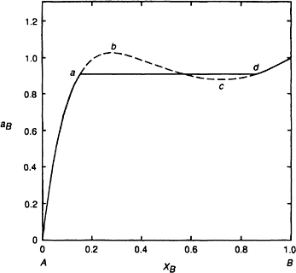
Gibbs Free Energy Composition and Phase Diagrams of Binary Systems 321
Figure 10.7 The activity of B at 800 K derived from Fig. 10.6a.
The value of 6a_{B}/6X_{B} is negative between b and c, and this violates an intrinsic criterion for stability which requires that 6a_{i}/6X_{i} always be positive [cf. (6P/6V)_{T}>0 over the portion JHF in Fig. 8.7]. Thus the derived activity curve between b and c, and, consequently, the Gibbs free energy of mixing curve between
the spinodal compositions, have no physical significance. The horizontal line drawn between a and d in Fig. 10.7 represents the actual constant activity of B in the two-phase region, and the compositions a and d are those of the double tangents to the Gibbs free energy of mixing curve.
10.5 LIQUID AND SOLID STANDARD STATES
Thus far the standard state of a component of a condensed system has been chosen as being the pure component in its stable state at the particular temperature and pressure of interest. At 1 atm pressure (the pressure normally considered), the stable state is determined by whether or not the temperature of interest is above or below the normal melting temperature of the component. In the discussion of condensed binary solutions, it has been tacitly assumed that the temperature of interest is above or below the melting temperatures of both components, i.e., Fig. 10.7 could be drawn for liquid immiscibility, in which case the standard states are the two pure liquids, or it could be drawn for solid immiscibility, in which case the standard states are the two pure solids. As the standard state of a component is simply a reference state to which the component in any other state

Slide 13

322 Introduction to the Thermodynamics of Materials
is compared, it follows that any state can be chosen as the standard state, and the choice is normally made purely on the basis of convenience.
Consider the binary system A–B at a temperature T which is below T_{m(B)}, the melting
temperature of B, and above T_{m(A)}, the melting temperature of A. Consider, further, that
this system forms Raoultian ideal liquid solutions and Raoultian ideal solid solutions. The phase diagram for the system and the temperature of interest, T, are shown in Fig. 10.8a. Fig. 10.8b shows the two Gibbs free energy of mixing curves of interest, curve I drawn for liquid solutions and curve II drawn for solid solutions. At the temperature T, the stable
states of pure A and B are located at OG^{M}=0, with pure liquid A located at X =1 (the
A
point a) and pure solid B located at X_{B}=1 (the point b). The point c represents the molar
Gibbs free energy of solid A relative to that of liquid A at the temperature T, and T>T_{m(A)},
then is a positive quantity which is equal to the negative of the molar Gibbs free energy of melting of A at the temperature T. That is,
and if then
that is, if
and
are independent of temperature,
(10.4)
Similarly, the point d represents the molar Gibbs free energy of liquid B relative to that of solid B at the temperature T, and, as T<T_{m(B)}, then is a positive

Slide 14
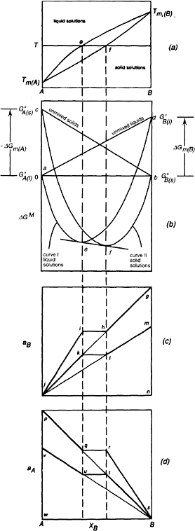
Gibbs Free Energy Composition and Phase Diagrams of Binary Systems 323
Figure 10.8 (a) The phase diagram for the system A–B. (b) The Gibbs free energies of mixing in the system A–B at the temperature T. (c) The activities of B at the temperature T and comparison of the solid and liquid standard states, (d) The activities of A at the temperature T, and comparison of the solid and liquid standard states.

Slide 15
324 Introduction to the Thermodynamics of Materials
quantity, equal to
The differences between and and and
and their dependence on temperature are shown in Figs. 7.1 and 7.2. The straight line in Fig. 10.8a joining a and d represents the Gibbs free energy of unmixed liquid A and liquid B relative to that of the standard state of unmixed liquid A and solid B, and the straight line joining c and b represents the Gibbs free energy of unmixed solid A and solid B relative to that of the standard state. The straight line cb has the equation
and the equation for the straight line ad is
At any composition the formation of a homogeneous liquid solution from pure liquid A
and pure solid B can be considered as being a two-step process involving
The melting of X_{B} moles of B, which involves the change in Gibbs free energy and
The mixing of X_{B} moles of liquid B and X_{A} moles of liquid A to form an ideal liquid solution, which involves the change in Gibbs free energy,
Thus, the molar Gibbs free energy of formation of an ideal liquid solution, liquid A and solid B is given by
from
(10.5)
which is the equation of curve I in Fig. 10.8b. Similarly, at any composition, the formation of an ideal solid solution from liquid A and solid B involves a change in Gibbs free energy of
(10.6)

Slide 16



Gibbs Free Energy Composition and Phase Diagrams of Binary Systems 325
which is the equation of curve II in Fig. 10.8b.
At the composition e, the tangent to the curve for the liquid solutions is also the tangent to the solid solution at the composition f. Thus, at the temperature T, liquid of composition e is in equilibrium with solid of composition f i.e., e is the liquidus composition and f is the solidus composition, as seen in Fig. 10.8a. As the temperature is varied, say, lowered, consideration of Figs. 7.1 and 7.2 shows that the magnitude of ca decreases and the magnitude of db increases. The consequent movement of the positions of curves I and II relative to one another is such that the positions e and f of the double tangent to the curves shift to the left. Correspondingly, if the temperature is increased, the relative movement of the Gibbs free energy curves is such that e and f shift to the right. The loci of e and f with change in temperature trace out the liquidus and solidus lines, respectively.
For equilibrium between the solid and liquid phases,
(10.7)
and
(10.8)
At any temperature T, these two conditions fix the solidus and liquidus compositions, i.e., the position of the points of double tangency. From Eq. (10.5)
Thus
(10.9)
From Eq. (9.33a)

Slide 17



326 Introduction to the Thermodynamics of Materials
and thus, adding Eq. (10.5) and (10.9) gives
(10.10)
From Eq. (10.6)
and thus
(10.11)
Adding Eqs. (10.6) and (10.11) gives
(10.12)
Thus, from Eqs. (10.7), (10.10), and (10.12)
(10.13)
Similarly, from Eqs. (10.5) and (9.33b)
(10.14)
and from Eqs. (10.6) and (9.33b)
(10.15)
Thus, from Eqs. (10.8), (10.14), and (10.15),
(10.16)

Slide 18





Gibbs Free Energy Composition and Phase Diagrams of Binary Systems 327
The solidus and liquidus compositions are thus determined by Eqs. (10.13) and (10.16) as follows. Eq. (10.13) can be written as
(10.17)
and, noting that X_{B}=1–X_{A}, Eq. (10.16) can be written as
(10.18)
Combination of Eqs (10.17) and (10.18) gives
(10.19)
and
(10.20)
Thus, if
in which case
(10.4)
it is seen that the phase diagram for a system which forms ideal solid and liquid solutions is determined only by the melting temperatures and the molar heats of melting of the components.
Example
The system Ge-Si exhibits complete ranges of liquid and solid solutions. (1) Calculate the phase diagram for the system assuming that the solid and liquid solutions are Raoultian in their behavior and (2) calculate the temperature at which the liquidus (and hence solidus) composition exerts its maximum vapor pressure.
Silicon melts at 1685 K, and its standard Gibbs free energy change on melting is

Slide 19




328 Introduction to the Thermodynamics of Materials
The saturated vapor pressure of solid Si is
Germanium melts at 1213 K and its standard Gibbs free energy change on melting is
The saturated vapor pressure of liquid Ge is
The equation of the liquidus line is then obtained from Eq. (10.20) as
and the equation of the solidus line is obtained from Eq. (10.19) as
The calculated liquidus and solidus lines are shown in comparison with the measured lines in Fig. 10.9a.
The partial pressure of Si exerted by the solidus composition (and hence by the corresponding liquidus melt) at the temperature T is
(i)

Slide 20
Gibbs Free Energy Composition and Phase Diagrams of Binary Systems 329
and the partial pressure of Ge exerted by the liquidus melt composition (and hence by the corresponding solidus) is
(ii)
Eqs. (i) and (ii), together with the sum of the partial pressures, are shown in Fig. 10.9b. In Eq. (i) the values of both X_{Si},_{(solidus)},T and increase with increasing liquidus
temperature, and thus the partial pressure of Si exerted by the liquidus composition increases from zero at 1213 K to the saturated vapor pressure of pure solid Si
at 1685 K. In contrast, in Eq. (ii), increasing the liquidus
temperature causes an increase in
and a decrease in X_{Ge},_{(liquidus)},_{T}, and Fig. 10.9b
shows that, at lower liquidus temperatures, the influence of on the partial pressure of Ge predominates and the partial pressure initially increases with increasing liquidus temperature. However, with continued increase in temperature along the liquidus line the relative influence of the dilution of Ge increases, and the partial pressure of Ge passes through a maximum at the liquidus state X_{Ge}=0.193, T=1621 K before decreasing
rapidly to zero at 1685 K. The maximum in the partial pressure of Ge causes a maximum in the total vapor pressure to occur at the liquidus state X_{Ge}=0.165, T=1630 K.
Fig. 10.10 shows the Gibbs free energy of mixing curves for a binary system A–B
which forms ideal solid solutions and ideal liquid solutions, drawn at a temperature of
500 K, which is lower than T_{m,(B)} and higher than T_{m,(A)}. At
and
Fig. 10.10a shows the curves when liquid A and solid B are
chosen as the standard states, located at OG^{M}=0, Fig. 10.10b shows the curves when

Slide 21
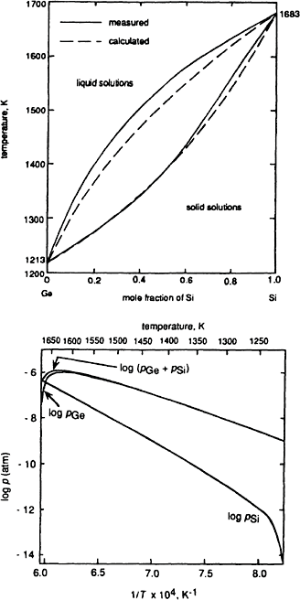
330 Introduction to the Thermodynamics of Materials
Figure 10.9 (a) The calculated phase diagram for the system Ge-Si assuming Raoultian behavior of the solid and liquid solutions, (b) The variations, with temperature, of the partial pressures of Ge and Si (and their sum) with composition along the liquidus line.

Slide 22
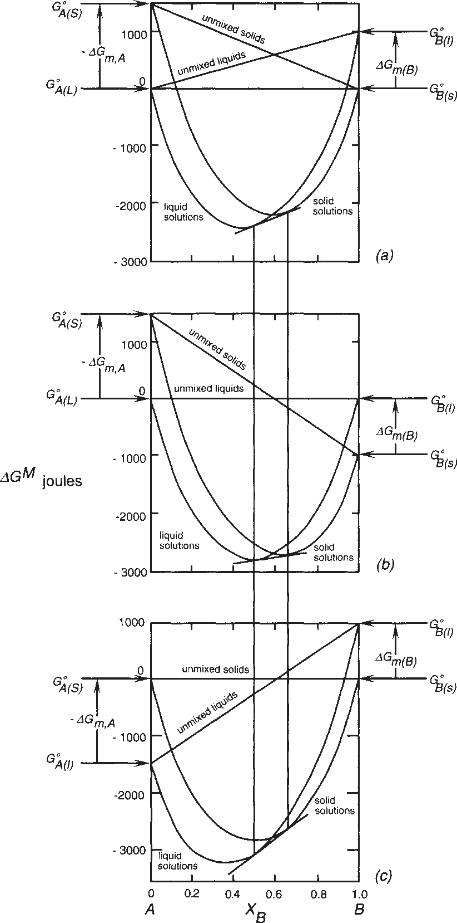
Gibbs Free Energy Composition and Phase Diagrams of Binary Systems 331
Figure 10.10 The Gibbs free energy of mixing curves for a binary system A–B which forms ideal solid solutions and ideal liquid solutions, at a temperature which is higher than T_{m(A)} and lower than T_{M(B)}.
(a) Liquid A and solid B chosen as standard states located at OG^{M}=0. (b) Liquid A and liquid B chosen as standard states located at OG^{M}=0. (c) Solid A and solid B chosen as standard states located at OG^{M}=0. The positions of the points of double- tangency are not influenced by the choice of standard state.

Slide 23

332 Introduction to the Thermodynamics of Materials
liquid A and liquid B are chosen as the standard states, and Fig. 10.10c shows the curves when solid A and solid B are chosen as the standard states. Comparison among the three shows that, because of the logarithmic nature of the Gibbs free energy curves, the positions of the points of double tangency are not influenced by the choice of standard state; they are determined only by the temperature T and by the magnitude of the difference between
and
for both components at the temperature T.
The activity-composition relationships for component B are shown in Fig. 10.8c. As two standard states are available, the point b for solid B and the point d for liquid B, the lengths of the tangential intercepts with the X_{B}=1 axis can be measured from b, in which
case the activities of B are obtained with respect to solid B as the standard state, or the lengths can be measured from d, which gives the activities with respect to liquid B as the standard state.
If pure solid B is chosen as the standard state and is located at the point g in Fig. 10.8c, then the length gn is, by definition, unity, and this defines the solid standard state activity scale. The line ghij then represents a_{B} in the solutions with respect to solid B having unit activity at g. The line is obtained from the variation of the tangential intercepts from the curve aefb to the X_{B}=1 axis, measured from the point b. On this activity scale Raoult’s
law is given by jg, and the points i and h represent, respectively, the activity of B in the coexisting liquid solution e and solid solution f. The point m represents the activity of pure liquid B measured on the solid standard state activity scale of B. This activity is less than unity, being given by the ratio mn/gn. For B in any state along the aefb Gibbs free
energy curve, in which state the partial molar Gibbs free energy of B is the following relations hold:
and
Thus
(10.21)

Slide 24

Gibbs Free Energy Composition and Phase Diagrams of Binary Systems 333
is a positive quantity, and thus the activity of B in any solution
As
with respect to solid B as the standard state is less than the activity of B with respect to liquid B as the standard state, where both activities are measured on the same (solid or liquid) activity scale. For pure B a_{B(s)}>a_{B(l)} i.e., gn>mn in Fig. 10.8c, and, if gn=1, then
Equation (10.21) simply states that the length of the tangential intercept from any point on the curve aefb, measured from b+ the length bd=the length of the tangential intercept from the same point on the curve measured from d, which is a restatement of Eq. (10.21).
If pure liquid B is chosen as the standard state and is located at the point m, then the length mn is, by definition, unity, and this defines the liquid standard state activity scale. Raoult’s law on this scale is given by the line jm, and the activities of B in solution, with respect to pure liquid B having unit activity, are represented by the line mlkj. The activity of solid B, located at g, is greater than unity on the liquid standard state activity scale,
being equal to exp (
) When measured on one or the other of the two activity
scales, the lines jihg and jklm vary in the constant ratio exp ( ) but jihg measured on the solid standard state activity scale is identical with jklm measured on the liquid standard state activity scale.
The variation of a_{A} with composition is shown in Fig. 10.8d. In this case, as
is a negative quantity, and hence, from Eq. (10.3) applied to
component A,
when measured on the same activity scale. If pure liquid A is chosen as the standard state and is located at the point p, then the length of pw is, by definition, unity, and the line pqrs represents the activity of A in the solution with respect to the liquid standard state. On the liquid standard state activity scale, the activity of pure solid A, located at the point
v, has the value exp ( ) If, on the other hand, pure solid A is chosen as the standard state, then the length of vw is, by definition, unity, and Raoult’s law is given by vs. The line vuts represents the activities of A in the solutions with respect to pure solid A. On the solid standard state activity scale, liquid A, located at the point p, has the value
exp ( ) Again, the two lines, measured on one or the other of the two activity
scales, vary in the constant ratio exp ( scales, are identical.
) and when measured on their respective
If the temperature of the system is decreased to a value less than T indicated in
Fig.10.8a, then the length of ac, being equal to |
| at the temperature of
interest, decreases, and, correspondingly, the magnitude of | |, and hence the length of bd, increase. The consequent change in the positions of the Gibbs free en- ergy of mixing curves I and II in Fig. 10.8b causes the double tangent points e and f to shift to the left toward A. The effect on the activities is as follows. In the case of both components,

Slide 25

334 Introduction to the Thermodynamics of Materials
which, from Eq. (10.4),
(10.22)
With respect to component B, if the temperature, which is less than T_{m(B)}, is decreased, the ratio a_{B(solid)}/a_{B(liquid)}, which is greater than unity, increases. Thus, in Fig. 10.8c, the
ratio gn/mn increases. With respect to the component A, if the temperature, which is higher than T_{m(A)}, is decreased, then the ratio a_{A(solid)/aA(liquid)}, which is less than unity,
increases. Thus the ratio vw/pw in Fig. 10.8d increases. At the temperature T_{m(B)}, solid
and liquid B coexist in equilibrium,
the points m and g coincide.
and the points p and v coincide.
Similarly, at the temperature
10.6 PHASE DIAGRAMS, GIBBS FREE ENERGY, AND THERMODYNAMIC ACTIVITY
Complete mutual solid solubility of the components A and B requires that A and B have the same crystal structures, be of comparable atomic size, and have similar electronegativities and valencies. If any one of these conditions is not met, then a miscibility gap will occur in the solid state. Consider the system A–B, the phase diagram of which is shown in Fig. 10.11a, in which A and B have differing crystal structures. Two terminal solid solutions, a and ß, occur. The molar Gibbs free energy of mixing curves, at the temperature T , are shown in Fig. 10.11b. In this figure, a and c, located at OG^{M}=0,
1
represent, respectively, the molar Gibbs free energies of pure solid A and pure liquid B,
and b and d represent, respectively, the molar Gibbs free energies of pure liquid A and pure solid B. The curve aeg (curve I) is the Gibbs free energy of mixing of solid A and solid B to form homogeneous a solid solutions which have the same crystal structure as has A. This curve intersects the X_{B}=1 axis at the molar Gibbs free energy which solid B would have if it had the same crystal structure as has A. Similarly, the curve dh (curve II) represents the Gibbs free energy of mixing of solid B and solid A to form homogeneous ß solid solutions which have the same crystal structure as has B. This curve intersects the X_{A}=1 axis at the molar Gibbs free energy which A would have if it had the same crystal
structure as B. The curve bfc (curve III) represents the molar Gibbs free energy of mixing of liquid A and liquid B to form a homogeneous liquid solution. As curve II lies everywhere above curve III, solid ß solutions are not stable at the temperature T₁. The
double tangent to the curves I and III identifies the a solidus composition at the temperature T₁ as e and the liquidus composition as f Fig. 10.11c shows the activity- composition relationships of the components at the temperature T₁, drawn with respect

